Slide 1


DevOps: Bridging Development and Operations
Welcome to this technical deep dive into DevOps principles, practices, and tooling. We'll explore how DevOps transforms software delivery through automation, collaboration, and continuous improvement.
by Mahendra js

Slide 2

What is DevOps

Slide 3
What is DevOps ?
DevOps (“development” and “operations”) is the combination of practices and tools designed to increase an organization’s ability to deliver applications and services faster than traditional software development processes.
This speed enables organizations to better serve their customers and compete more effectively in the market.
Under a DevOps model, development and operations teams work together across the entire software application life cycle, from development and test through deployment to operations.

Slide 4

Key Business Benefits
46x
More Deployments
High-performing teams deploy code more frequently.
96%
Faster Recovery
Reduced mean time to recover from failures.
440x
Lead Time
Faster from commit to deployment.
5x
Lower Failure Rate
Fewer production deployments fail.

Slide 5
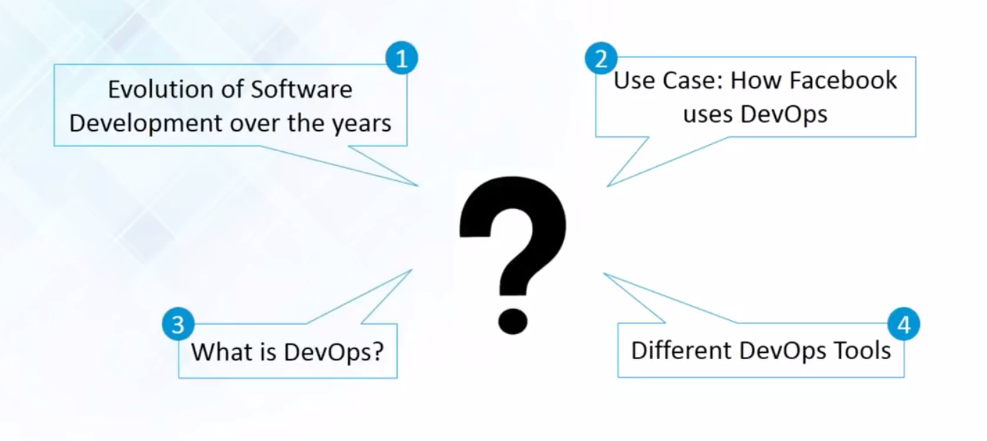
Do you know the following :

Slide 6
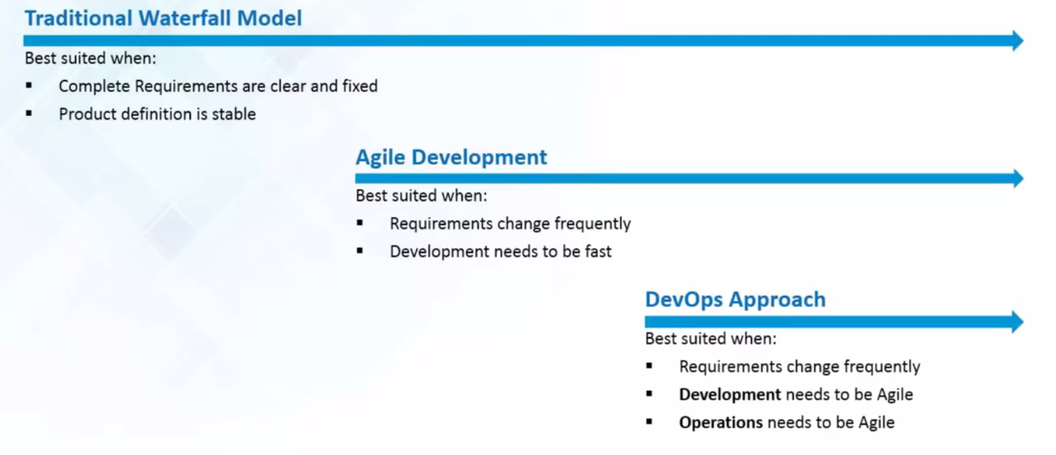
Evolution of Software Development

Slide 7
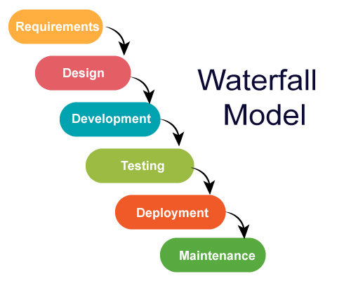
Waterfall Model
The waterfall model is a linear, sequential approach to the software development life cycle (SDLC) that is popular in software engineering and product development.
The waterfall model emphasizes a logical progression of steps.
The waterfall model is used especially in software development.

Slide 8
Agile Model
Agile SDLC model is a combination of iterative and incremental process models with focus on process adaptability and customer satisfaction by rapid delivery of working software product.
Agile Methods break the product into small incremental builds. These builds are provided in iterations.
Agile model believes that every project needs to be handled differently, and the existing methods need to be tailored to best suit the project requirements.
In Agile, the tasks are divided to time boxes (small time frames) to deliver specific features for a release.

Slide 9
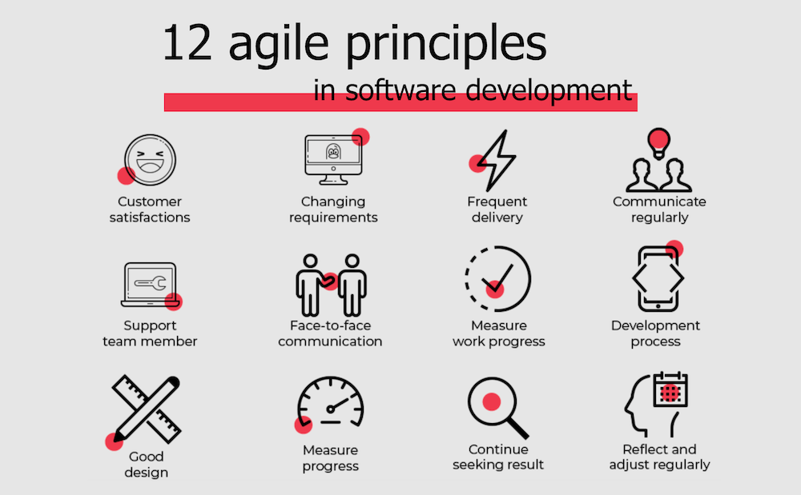
Agile Principles

Slide 10
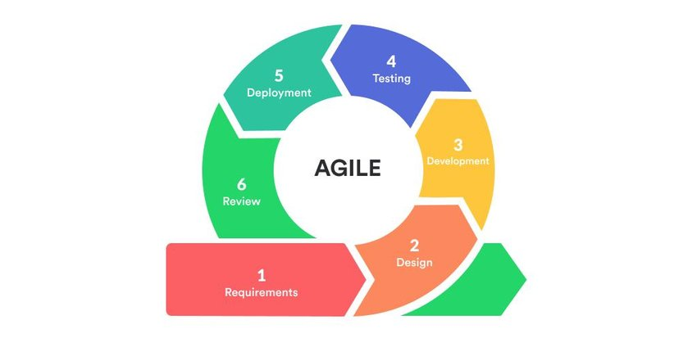
Agile Model
Agile uses an adaptive approach where there is no detailed planning and there is clarity on future tasks only in respect of what features need to be developed.
There is feature driven development and the team adapts to the changing product requirements dynamically.
The product is tested very frequently, through the release iterations, minimizing the risk of any major failures in future.
Customer Interaction is the backbone of this Agile methodology, and open communication with minimum documentation are the typical features of Agile development environment.

Slide 11
Advantages of Agile model
Is a very realistic approach to software development.
Promotes teamwork and cross training.
Functionality can be developed rapidly and demonstrated.
Resource requirements are minimum.
Suitable for fixed or changing requirements
Delivers early partial working solutions.
Good model for environments that change steadily.
Minimal rules, documentation easily employed.
Enables concurrent development and delivery within an overall planned context.
Little or no planning required.
Easy to manage.

Slide 12
Agile Framework
An Agile framework is a specific approach to planning, managing, and executing work.
Agile frameworks typically fall into two categories: Frameworks designed for teams, and frameworks designed to help organizations practice Agile at scale, across many teams.
Scrum: Scrum breaks down big projects into small tasks that can be completed in short development cycles.
Crystal: The Crystal framework is used for short-term projects involving teams located in the same workspace. There are no firm rules to follow with this approach.
Kanban: Kanban is visual and incremental. Transparency into project statuses is key, so tasks are laid out on a board and categorized as to do, in progress, or done.

Slide 13
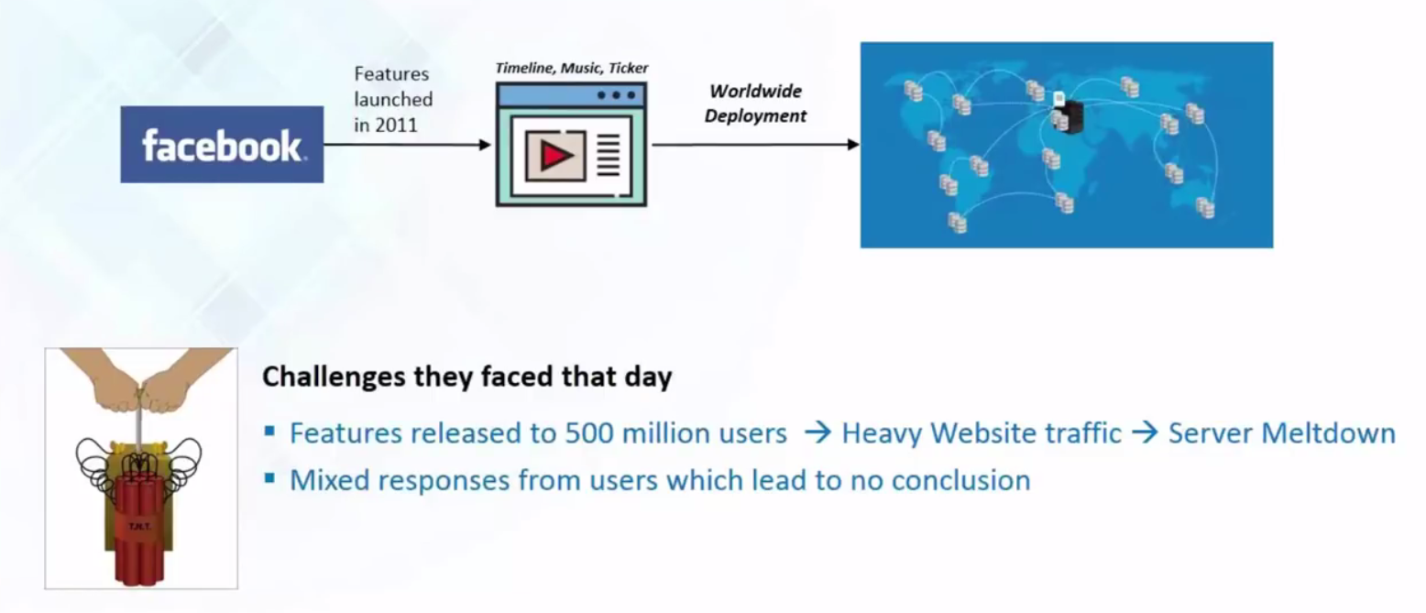
Use Case 2011 : Facebook

Slide 14
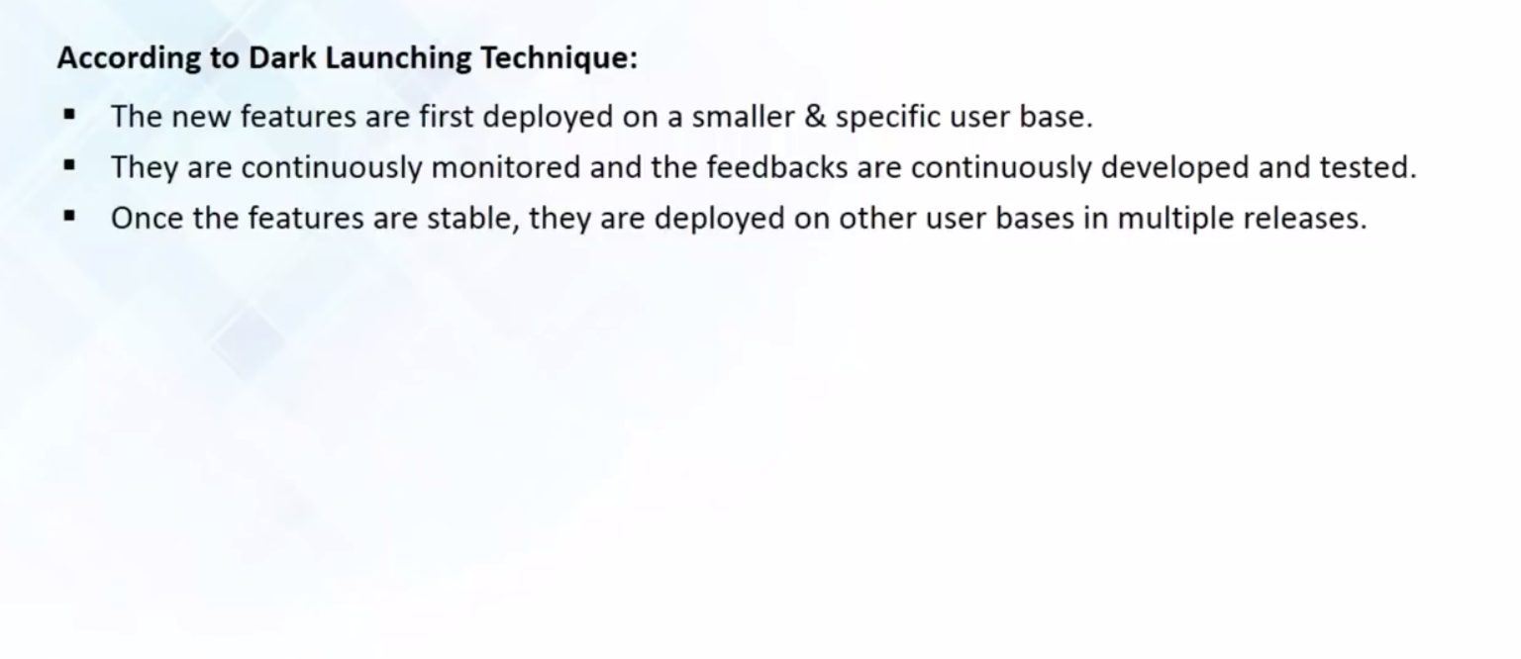
The Dark Launching Technique

Slide 15
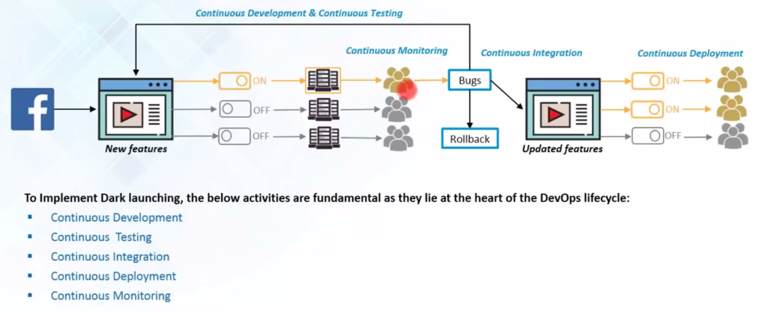
The Dark Launching Technique

Slide 16
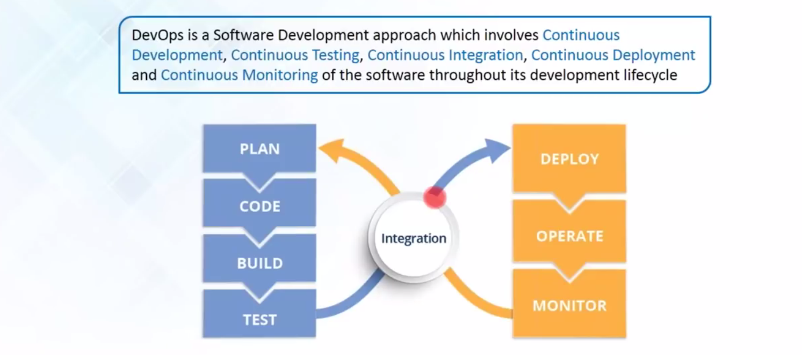
What is DevOps ?

Slide 17
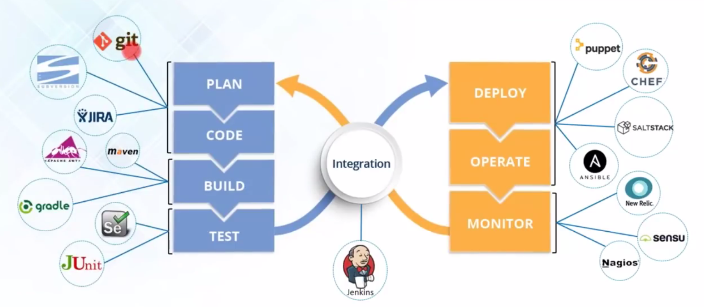
DevOps Tools

Slide 18

The History of DevOps
The evolution of DevOps represents one of the most significant paradigm shifts in software development and IT operations over the past two decades. This transformative approach has fundamentally changed how organizations build, deploy, and maintain software systems.
From its humble beginnings as a grassroots movement to its current status as an essential practice in modern technology organizations, DevOps has revolutionized the speed, quality, and reliability of software delivery. Throughout this presentation, we'll trace the fascinating journey of DevOps and explore how it has reshaped the technology landscape.
by Mahendra js

Slide 19
The Pre-DevOps Era
Siloed Teams
Waterfall Methodology
Manual Processes
Development created code with limited understanding of operational constraints. Operations managed production environments with minimal input from developers. These walls between teams created significant friction and inefficiency.
Software development followed rigid sequential phases, with long cycles from conception to deployment. Requirements were specified upfront, with little flexibility for adaptation during development.
Deployments required extensive manual work with error-prone handoffs between teams. Release cycles could take months, with extensive downtime and high failure rates. Testing was often insufficient and conducted late in the process.
This fragmented approach created significant business challenges, including slow time-to-market, quality issues, and frustrated teams spending excessive time on repetitive tasks rather than innovation.

Slide 20




The Birth of DevOps (2007-2009)
2007: The Term Emerges
Patrick Debois experiences frustration with the divide between development and operations while working on a government project in Belgium, sparking ideas about integration.
2009: Velocity Conference
John Allspaw and Paul Hammond deliver their groundbreaking "10+ Deploys Per Day" presentation, demonstrating how Flickr bridged dev and ops teams.
2009: First DevOpsDays
Patrick Debois organizes the first DevOpsDays conference in Ghent, Belgium, officially launching the DevOps movement as a community-driven initiative.
These pivotal moments marked the beginning of a movement that would fundamentally transform how software teams operate. The seeds planted during this period would grow into practices adopted by organizations worldwide.

Slide 21




Early DevOps Adoption (2010-2012)
CI/CD Emerges
Infrastructure as Code
The Phoenix Project
Continuous Integration and Continuous Delivery become foundational DevOps practices, enabling automated testing and deployment.
Tools like Puppet and Chef gain popularity, allowing infrastructure to be defined, versioned, and deployed like application code.
Gene Kim's novel introduces DevOps concepts through storytelling, making them accessible to broader business audiences.
During this period, early adopters began demonstrating the significant benefits of DevOps practices. Companies implementing these approaches reported deployment frequencies increasing from months to days or even hours, while simultaneously improving stability and quality.

Slide 22



DevOps Goes Mainstream (2013-2015)
Enterprise Adoption
Major companies like Netflix, Amazon, and Google showcase DevOps success stories
Containerization Revolution
Docker simplifies application packaging and deployment across environments
DevOps Toolchain Explosion
Specialized tools for every aspect of the development lifecycle proliferate
This period marked the transition of DevOps from a niche practice to an industry standard. The State of DevOps Report began annual publication, providing data-driven insights into DevOps adoption and benefits. Companies implementing DevOps reported deploying code 30 times more frequently with 60 times fewer failures.

Slide 23








DevOps Evolution (2016-2018)
DevSecOps
Microservices
Security shifts left in the development process, becoming integrated throughout rather than applied at the end.
Applications are decomposed into smaller, independently deployable services, enabling more flexible development and scaling.
Kubernetes
Cloud-Native
Google's open-source container orchestration platform becomes the industry standard for managing containerized applications.
Organizations design applications specifically to leverage cloud capabilities and dynamic infrastructure.
This period saw DevOps practices mature and specialize, with greater emphasis on security integration and architectural approaches that complemented DevOps workflows. Organizations moved beyond simple deployment automation to building comprehensive delivery platforms.

Slide 24






Modern DevOps (2019-Present)
AI-Powered Operations
Machine learning for predictive analytics and automated remediation
GitOps & IaC Maturity
Git repositories as the single source of truth for infrastructure
Observability Focus
Beyond monitoring to understanding complex distributed systems
Modern DevOps has shifted focus from just "shipping fast" to creating comprehensive systems that maintain reliability at scale. Platform engineering teams now build internal developer platforms that abstract complexity and provide self-service capabilities to development teams.
The COVID-19 pandemic accelerated digital transformation efforts, making DevOps capabilities even more critical as organizations needed to adapt quickly to changing market conditions and support remote work environments.

Slide 25



The Future of DevOps
Hyperautomation
Edge Computing Integration
Enterprise-Wide Adoption
AI-driven autonomous operations will reduce human intervention in routine tasks, allowing teams to focus on innovation. Expect self-healing systems that can detect, diagnose, and remediate issues without human intervention.
DevOps practices will extend to edge environments and IoT devices, requiring new approaches to deployment, monitoring, and security for highly distributed systems operating in resource-constrained environments.
DevOps principles will expand beyond technology to transform business operations across departments. Concepts like version control, automation, and continuous improvement will be applied to finance, marketing, and other business functions.
As DevOps continues to evolve, the distinction between development and operations may eventually disappear entirely. Instead, we may see the emergence of product engineering teams with end-to-end responsibility for building, deploying, and operating software systems throughout their entire lifecycle.

Slide 26
DevOps Evolution Timeline
2007-2008
1
Frustration grows between dev and ops teams. Siloed approaches create bottlenecks.
2
2009
Term "DevOps" coined at Velocity Conference. Patrick Debois organizes first DevOpsDays.
2010-2013
3
Early tooling emerges. Chef, Puppet gain popularity. Continuous integration concepts spread.
4
2014-2016
Docker and containerization revolutionize deployment. Microservices architectures gain traction.
2017-Present
5
GitOps, MLOps, and DevSecOps expand the model. Enterprise adoption accelerates.

Slide 27








DevOps Stakeholders & Goals
Developers
Operations
Seeking faster feedback, self-service infrastructure, and streamlined processes.
Aiming for stability, observability, and automated infrastructure.
Security/Compliance
Product/Business
Requiring policy adherence, vulnerability management, and risk reduction.
Wanting faster feature delivery, reduced costs, and competitive advantage.

Slide 28








DevOps Core Principles
Culture
Automation
Shared responsibility and collaboration.
Eliminate manual, repetitive tasks.
Sharing
Measurement
Knowledge exchange across teams.
Data-driven improvement decisions.

Slide 29
Traditional vs. DevOps Approach
Traditional Approach
DevOps Approach
Siloed teams
Collaborative teams
Manual processes
Automated processes
Infrequent deployments
Frequent deployments
Higher failure rates
Lower failure rates
Slower recovery times
Faster recovery times

Slide 30
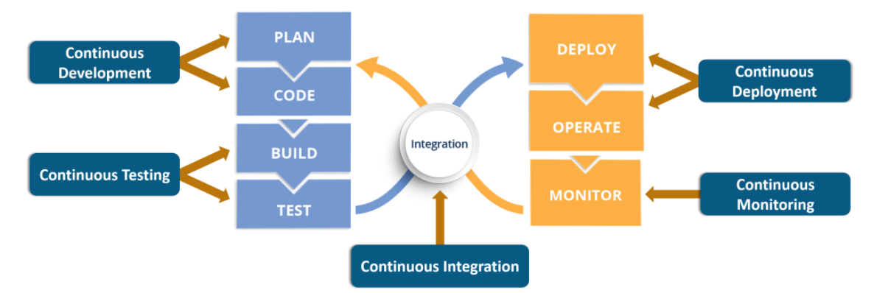
DevOps Lifecycle Phase

Slide 31









DevOps in the SDLC
Code
Plan
Collaborative development with version control and code reviews
Requirements gathering and task breakdown in agile boards
Build & Test
Automated builds and comprehensive testing suites
Monitor
Telemetry, alerting, and continuous feedback loops
Deploy
Infrastructure as code and continuous delivery pipelines

Slide 32
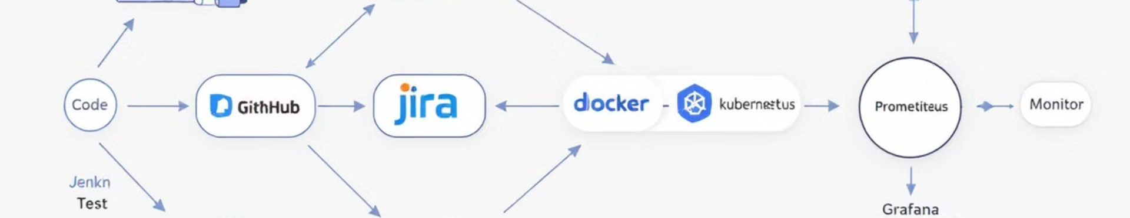
Essential DevOps Toolchain
Source Control & CI/CD
Infrastructure & Config
Monitoring & Observability
Git, GitHub, GitLab
Terraform, CloudFormation
Prometheus, Grafana
Jenkins, CircleCI, GitHub Actions
Ansible, Chef, Puppet
New Relic, Datadog
Kubernetes, Docker, Helm
ELK Stack, Jaeger
ArgoCD, Spinnaker, Tekton

Slide 33
Q1: What is DevOps?
DevOps is a methodology that promotes collaboration between development and operations teams, aiming to streamline software development, delivery, and deployment processes.
Q2. What are the key benefits of implementing DevOps?
DevOps offers several benefits, including faster software delivery, improved collaboration and communication, enhanced quality and reliability, increased efficiency and productivity, and better customer satisfaction.
Q3: Which tools are commonly used in DevOps?
Popular DevOps tools include Git, Jenkins, Ansible, Docker, Puppet, Chef, Nagios, Kubernetes, and Azure DevOps. These tools assist in various aspects of the software development lifecycle, such as version control, continuous integration, configuration management, and containerization.

